Slide 1

Linux Device Drivers
Lection 1
Roman Okhrimenko 2019

Slide 2
Questions to answer on this lection
1. What is Linux Kernel and how I can get one?
2. What are kernel functions in operating system?
3. What are Linux kernel considerations?
4. Which subsystems kernel consist of?
5. Monolithic vs microkernel?
6. What is a kernel module and how it it used?
7. Drivers are modules but not vice versa?
8. Different types of drivers
9. What does it mean ”Everything is a file”?
10. How can I use special file systems, like /proc /dev/ /sys and other?

Slide 3
What is Kernel?
Kernel:
It is a computer program
it is a core application in all operating systems
It boots up system and always stays in memory
It handles low level system operations and boot
It handles memory management and distribution
It handles I/O devices and peripherals
It handles scheduling of processes and processor time quota
Provides unified System Call interface for other processes

Slide 4
How I can get a Kernel?
Write your own - https://wiki.osdev.org/Getting_Started
Use one of existing
Linux - https://github.com/torvalds/linux
FreeBSD - https://github.com/freebsd/freebsd
uclinux - https://github.com/EmcraftSystems/linux-emcraft
Xv6 - https://pdos.csail.mit.edu/6.828/2019/xv6.html
3. There are mikrokernels also
http://www.microkernel.info/
4. And RTOS kernels
FreeRTOS - https://www.freertos.org/
Zephyr - https://www.zephyrproject.org/
Mbed-os - https://www.mbed.com/en/platform/mbed-os/
Notes:
Mention Ajax systems, that wrote their own operating system for their products

Slide 5
Linux Kernel features
Written in C and assembler
Portability and hardware support.
Runs on most architectures.
Scalability. Can run on super computers as well as on tiny devices (4 MB of RAM is enough).
Compliance to standards and interoperability.
Exhaustive networking support.
Security.
It can’t hide its flaws. Its code is reviewed by many experts.
Stability and reliability.
Modularity. Can include only what a system needs even at run time.
Easy to program. You can learn from existing code. Many useful resources on the net.

Slide 6
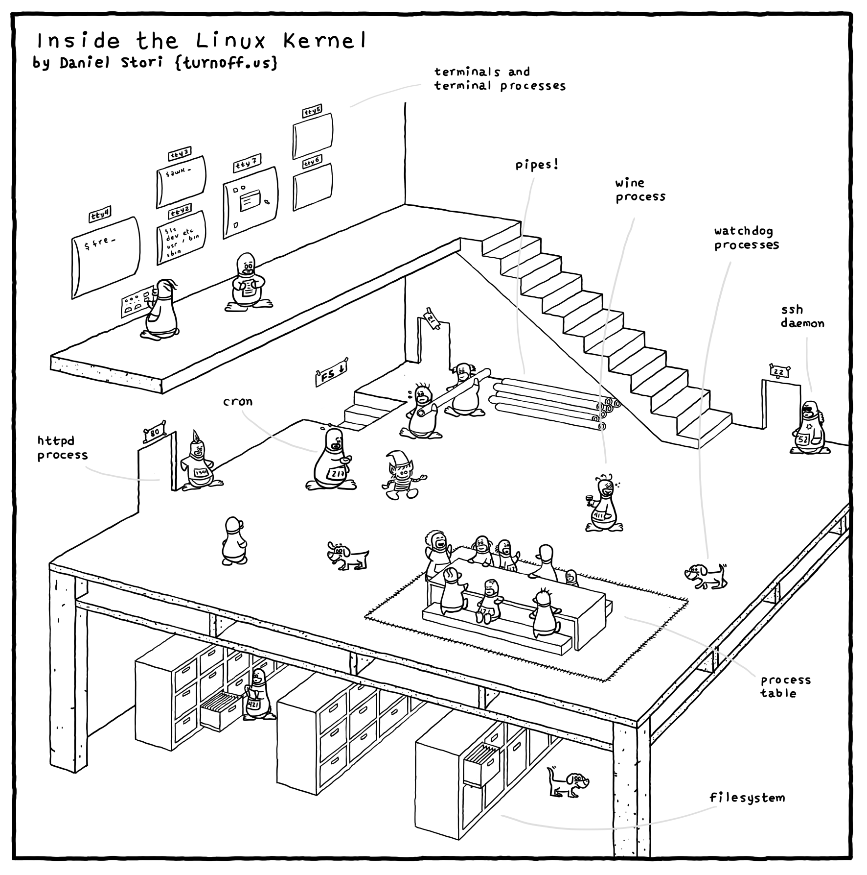
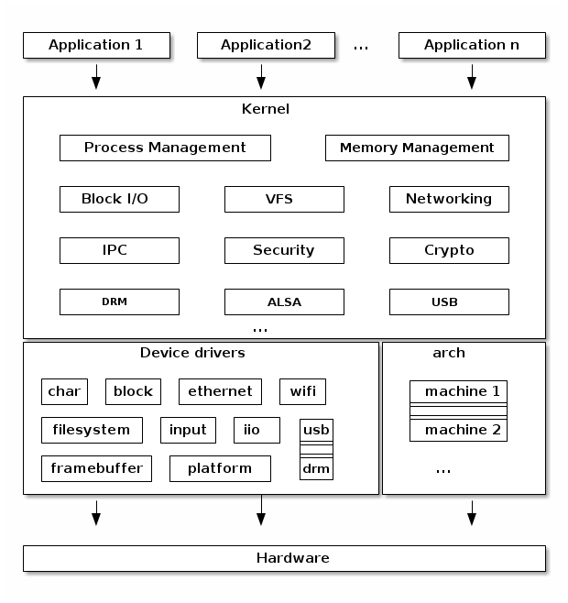
Linux Kernel features
http://turnoff.us/geek/inside-the-linux-kernel/
https://linux-kernel-labs.github.io/master/lectures/intro.html#monolithic-kernel

Slide 7
Linux Kernel considerations
The kernel has to be standalone and can’t use user space code
Floating point numbers in kernel code are never used
No stable in kernel API
The internal kernel API to implement kernel code can undergo changes between two releases
In-tree drivers are updated by the developer proposing the API change
An out-of-tree driver compiled for a given version may no longer compile or work
The kernel to user space API does not change
No memory protection
The kernel doesn’t try to recover from attemps to access illegal memory locations
Fixed size stack (8 or 4 KB)
No C library – no printf – printk instead

Slide 8
Linux Kernel subsystems
Scheduler – share process time between lots of processes, implements SMP, ASMP, IPC and various mechanisms to support efficient load distribution in system
Memory management (HIGHMEM, virtual memory) – defines memory spaces for kernel and user space processes by request, provides a mapping between process memory references and the machine's physical memory
Networking – implements all the connectivity related protocols and hardware support
USB – implements universal serial bus protocols and infrastructure
Virtual Filesystem – implements software layer in the kernel that provides the filesystem interface to userspace programs. It also provides an abstraction within the kernel which allows different filesystem implementations to coexist
Hardware architecture – implements platform specific code for kernel
Other – power management, crypto, IPC, modules, init, interrupt handling
Notes:
MM - provides a mapping between process memory references and the machine's physical memory. The memory manager subsystem maintains this mapping on a per process basis, so that two processes can access the same virtual memory address and actually use different physical memory locations. In addition, the memory manager subsystem supports swapping; it moves unused memory pages to persistent storage to allow the computer to support more virtual memory than there is physical memory.

Slide 9
Monolithic vs Micro-kernel
A monolithic kernel is one where there is no access protection between the various kernel subsystems and where public functions can be directly called between various subsystems.
Most monolithic kernels do enforce a logical separation between subsystems especially between the core kernel and device drivers with relatively strict APIs (but not necessarily fixed in stone) that must be used to access services offered by one subsystem or device drivers. This, of course, depends on the particular kernel implementation and the kernel’s architecture.
A micro-kernel is one where large parts of the kernel are protected from each-other, usually running as services in user space. Because significant parts of the kernel are now running in user mode, the remaining code that runs in kernel mode is significantly smaller, hence micro-kernel term.
One of the advantages of this architecture is that the services are isolated and hence bugs in one service won’t impact other services.
Notes:
In a micro-kernel architecture the kernel contains just enough code that allows for message passing between different running processes. Practically that means implement the scheduler and an IPC mechanism in the kernel, as well as basic memory management to setup the protection between applications and services.

Slide 10
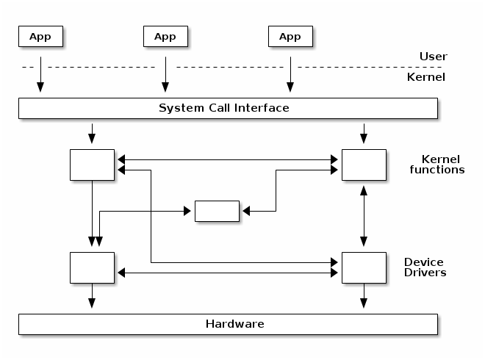
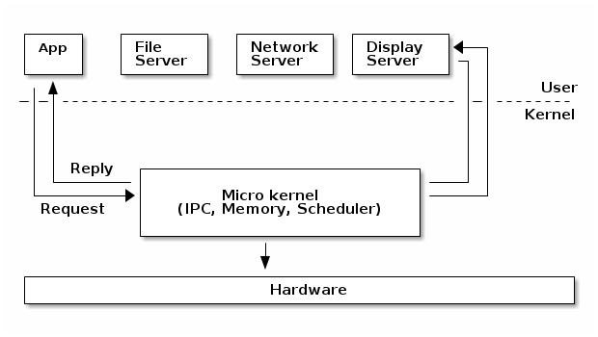
Monolithic vs Microkernel
https://linux-kernel-labs.github.io/master/lectures/intro.html
Monolithic
Micro

Slide 11
Monolithic vs Microkernel
Mono + modules + isolation => Micro
Components can enabled or disabled at compile time
Support of loadable kernel modules (at runtime)
Organize the kernel in logical, independent subsystems
Strict interfaces but with low performance overhead: macros, inline functions, function pointers

Slide 12
Linux Kernel Modules
Module is a kernel object which can be compiled and installed in system on demand and independently of main kernel image.
Introduce new functionality to compiled and running kernel
Help to keep the main kernel image size to the minimum
Help to reduce boot time: you don’t spend time initializing devices and kernel features that you only need later.
Modules make it easy to develop drivers without rebooting: load, test, unload, rebuild, load...
Consideration: once loaded, have full control and privileges in the system.
No particular protection. That’s why only the root user can load and unload modules.
May have dependencies on each other which implies dep management

Slide 13
Linux Kernel Modules
#include <linux/init.h>
#include <linux/module.h>
#include "md.h"
MODULE_LICENSE( "GPL" );
MODULE_AUTHOR(”Jonh Doe <john.doe@foobar.com>" );
char* md1_data = ”Hello world!";
extern char* md1_proc( void ) {
return md1_data;
}
static char* md1_local( void ) {
return md1_data;
}
extern char* md1_noexport( void ) {
return md1_data;
}
EXPORT_SYMBOL( md1_data );
EXPORT_SYMBOL( md1_proc );
static int __init md_init( void ) {
printk( "+ module md1 start!\n" );
return 0;
}
static void __exit md_exit( void ) {
printk( "+ module md1 unloaded!\n" );
}
module_init( md_init );
module_exit( md_exit );
#include <linux/init.h>
#include <linux/module.h>
#include "md.h"
MODULE_LICENSE( "GPL" );
MODULE_AUTHOR( “Jonh Doe <john.doe@foobar.com>");
static int __init md_init( void ) {
printk( "+ module md2 start!\n" );
printk( "+ data string exported from md1 : %s\n", md1_data );
printk( "+ string returned md1_proc() is : %s\n", md1_proc() );
return 0;
}
static void __exit md_exit( void ) {
printk( "+ module md2 unloaded!\n" );
}
module_init( md_init );
module_exit( md_exit );
extern char* md1_data;
extern char* md1_proc( void );

Slide 15
Device drivers types
Network devices are represented as network interfaces and are visible when issuing ifconfig command from userspace.
Block devices provide us- userspace applications with access to raw storage hardware devices (e.g. hard disks). These are visible to userspace as device files in /dev directory.
Character devices - they provide userspace applications with access to other types of devices such as input/output, serial, graphics, or sound and more.

Slide 16
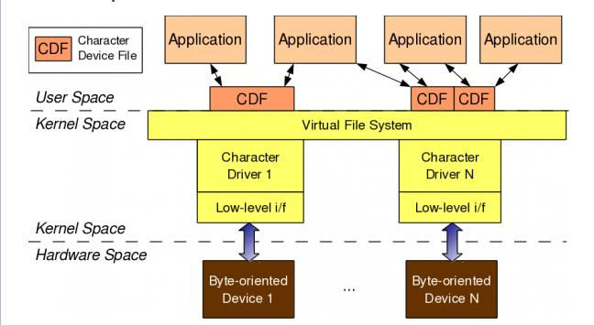
Character device drivers
Linux character device drivers are the kernel code that gets access to data from a hardware device sequentially.
http://www.opensourceforu.com/2011/02/linux-character-drivers
Notes:
The first character of the first column in figure 6 identifies the type of a device. Device files for character drivers are identified by a “c” which stands for character. Block devices are identified by a “b” which stands for block.

Slide 17
Character device drivers
Major numbers are used to distinguish between different types of drivers.
Minor numbers are used to distinguish between different instances of a driver.
Character driver must implement and register entry points or methods that enable userspace applications to manipulate the device as a file
struct file_operations
struct cdev
Notes:
Open text editor with linux kernel here and show file_operations structure in linux/fs.h startling from line 1814; emphasise that Linus Torvalds has touched that line 15 years ago.
cdev.h in include/linux/cdev.h

Slide 18
Everything is a file
C language > Unix > > Linux
In the Unix design philosophy, everything is a file.
This allows the system to represent system objects as files, and applications manipulate all system objects with files by means of normal file APIs, for example, open, read, write, and close.
Notes:
The first character of the first column in figure 6 identifies the type of a device. Device files for character drivers are identified by a “c” which stands for character. Block devices are identified by a “b” which stands for block.

Slide 19
References
https://bootlin.com/doc/training/linux-kernel/
https://linux-kernel-labs.github.io/master/lectures/intro.html
https://www.kernel.org/doc/html/latest/filesystems/vfs.html
https://www.ibm.com/developerworks/ru/library/l-linux_kernel_01/index.html
http://www.opensourceforu.com/2011/02/linux-character-drivers

